Slide 1
Python Excel Automation
Shyam Bhagat

Slide 2

Introduction

Slide 3
My Info
Name: Shyam Bhagat
Official Email: shyamb@quinnox.com
Phone: 9833958999

Slide 4
Why Python????
Simple to Learn
Simple to implement
Build Anything in fewer code

Slide 5
What you need to learn Python?
Basic knowledge of any programming language
Understanding of any tabular data
Simple Plain English

Slide 6
Python Features
Very widely used Language
Python is now a very widely used general-purpose, and a interpreted, object oriented, high-level programming language.
Simple and Easy to Learn
Python is a simple and minimalistic language in nature
Reading a good python program should be like reading English
Its Pseudo-code nature allows one to concentrate on the problem rather than the language
Python is Free and Open Source
The Python interpreter is developed under an OSI-approved open-source license, making it free to install, use, and distribute, even for commercial purposes. Free & Open source
Maintained by the Python community

Slide 7
Python Features
Cross-platform Language and Portable
Python works on different platforms like Windows, Linux, Mac, etc. Because Python code is interpreted and not compiled into native machine instructions, code written for one platform will work on any other platform that has the Python interpreter installed.
Supports the Multiple Programming Paradigms
The language also supports the multiple programming paradigms
Object Oriented programming paradigms
Procedure Oriented programming paradigms
Functional programming paradigms

Slide 8
Python Features
Huge Set of Libraries
Python Libraries has a huge set of useful libraries used in almost all areas. From Data Science to Artificial Intelligence, from creating Web Applications to Office Automation, who will get libraries for every task freely available on the Internet and eliminate the need for writing codes from scratch.
There are over 137,000 python libraries present till September 2020.
General Purpose Programming Language
Standalone Applications (CUI & GUI)
Dynamic Web Applications (Instagram, Google, Spotify, Netflix, Uber, Dropbox, reddit, Quora, Facebook etc)
Large Scale Enterprise Applications (Banking App, Stock App etc)
Data Science and Machine Learning Implementations
IoT and Machine Learning Applications
Artificial intelligence, Data science and Natural Language Processing,

Slide 9
Python Features
Inbuilt Memory Management
Python handles most of the hard parts of memory management for you. It keeps track of the number of references to each object in the program. When an object's reference count drops to zero, the garbage collector automatically frees the memory from that particular object.
But it's not that Simple
For all its syntactical simplicity, Python supports most constructs that would be expected in a very high-level language, including complex dynamic data types, structured and functional programming, and object-oriented programming.

Slide 10
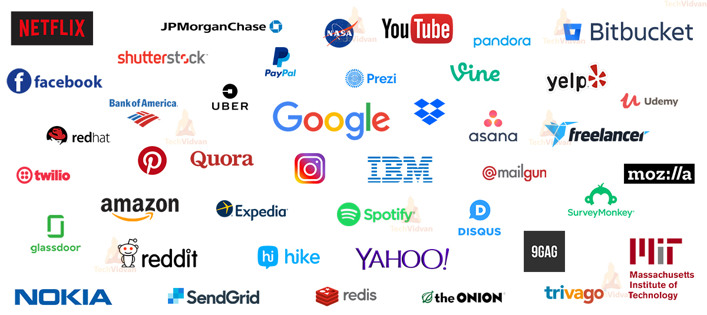
Major Companies using Python

Slide 11
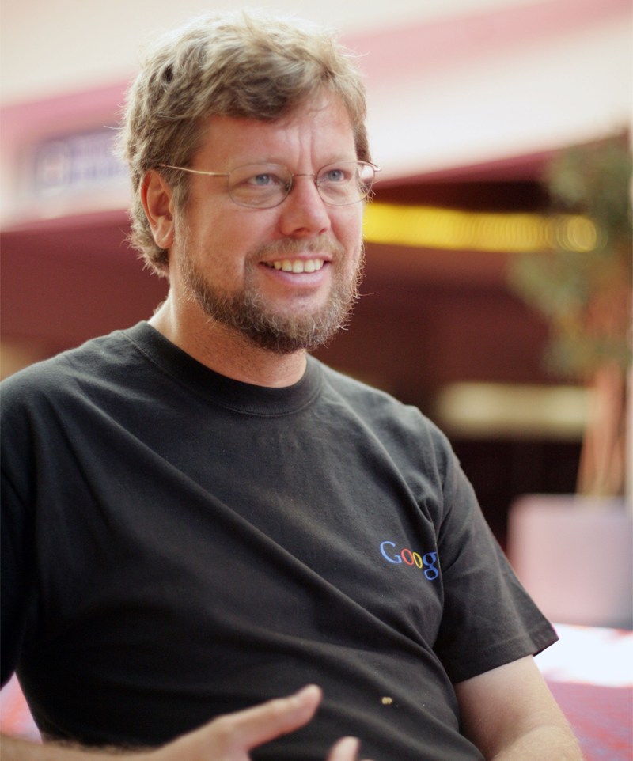
History of Python
Created in 1989 by Guido van Rossum
Created as a scripting language for administrative tasks
Based on All Basic Code (ABC) and Modula-3
Added extensibility
Named after comic troupe Monty Python
Released publicly in 1991
Growing community of Python developers
Evolved into well-supported programming language
Python Web site at www.python.org
Primary distribution center for Python source code, modules and documentation

Slide 12
History of Python
Python 0.9 (1991)
1.0 (1994)
1.5 (1998)
1.6 (2000)
2.0 (2000)
2.1 (2001)
2.2 (2001)
2.3 (2003)
2.4 (2004)
2.5 (2006)
2.6 (2008)
2.7 (2010)
3.0 (2008)
3.1 (2009)
3.2 (2011)
3.3 (2012)
3.4 (2014)
3.5 (2015)
3.6 (2016)
3.7 (2018)
3.8 (2019)
3.9 (2020)
3.10 (2021)

Slide 13
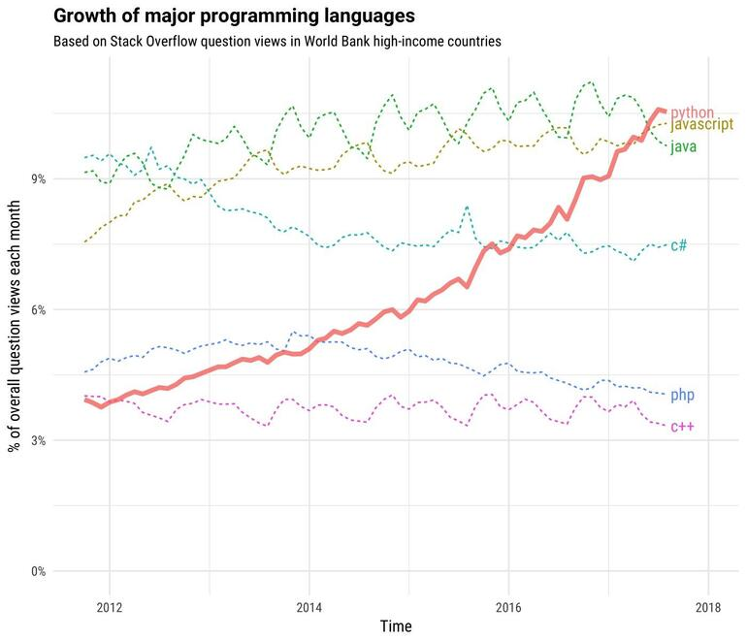
Growth of Python

Slide 14
Compiled vs Interpreted
Compiler Language
A compiler takes the source code and turns the code into machine understandable form which is stored in the single or multiple executable files.
If program has any syntax or technical errors in any part of the code, compiler will not allow to build executable file.
Compiled programs run faster because compilation is done before execution.
Memory requirement is more due to the creation of object code.
Source code => Compiler => Machine Code => Output
e.g: C,C++
Interpreter Language:
An interpreter runs source code line-by-line. It looks at each line and evaluates it just before running it.
Interpreter takes your code and reads it line by line and points out the error whenever it encounters an error, it won't read your next line if you do not remove the error.
Interpreted programs run slower because compilation and execution take place simultaneously.
Memory requirement is less.
Source Code => Interpreter => Output
e.g: Perl, Python, Matlab

Slide 15
Setting up Python Programming Environment
Python 3.8
VS Code
Microsoft Visual C++ 14.0 Build Tools

Slide 16
VS Code Extensions
Python
Pylance
Magic Python
Python Indent
Bracket Pair Colorizer 2
vscode-icons
Guides
Python-autopep8
Run on Save

Slide 17
Python Packages
numpy
scipy
pandas
matplotlib
beautifulsoup4
autopep8
pyexcel
pyexcel-xls
pyexcel-xlsx
Pyodbc
openpyxl
requests
urllib3
SQLAlchemy
pprintpp
yfinance

Slide 18
Install at once
pip install numpy scipy pandas matplotlib beautifulsoup4 autopep8 pyexcel pyexcel-xls pyexcel-xlsx pyodbc openpyxl requests urllib3 SQLAlchemy pprintpp

Slide 19


